Slide 2
What Are Budgets?
A budget is a calculated estimate of future income and expenses.
These plans are important for both individuals and businesses so that they can ensure that their essential expenses are covered before money is spent on things they would like but don’t need, like going to the movies or having a staff party. It also allows for planed saving for emergency expenses which may arise.

Slide 3
Why Are Budgets Important?
Budgets allow you to keep easy control over your money.
It ensures that money is not wasted or spent on frivolous things.
It helps people save.
It helps you monitor your spending habits.
It helps you stay out of debt.

Slide 4
When Are Budgets Drawn Up?
Budgets are drawn up by individuals, businesses and the Government.
Individuals usually draw up their household budgets each month while businesses will draw up budgets monthly, quarterly (every three months) or annually (one a year). The monthly and quarterly budgets are often referred to as short term budgets and the annual budget a long term budget.

Slide 5
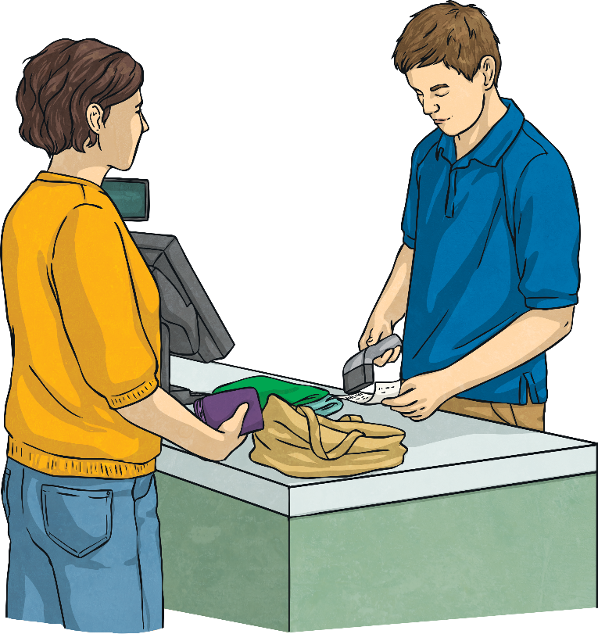
Balanced Budgets
The ideal budget will leave money left over after all the expenses have been paid. This is called a balanced budget.
Unfortunately this does not always happen. Sometimes our expenses are greater than our income. So what could you do if you discover that your budget is not balanced?
The first thing that you could do is identify items on your budget that are wants and not needs. Remove any items that you could live without for another month.
The next thing you could do is find ways of saving money on some of the expenses. Buy cheaper brands, walk more instead of driving everywhere etc.

Slide 6
Balanced Budgets
Sometimes we are faced with situations where our budget does not balance because of an unforeseen circumstance such as a serious illness or an accident.
In cases like this you would need to use some of your savings to cover the difference. If you don’t have any savings you would need to either borrow money from a friend or from the bank.
Types of loans from the bank would include a personal loan or an overdraft. You could also get a credit card from the bank which can be used to pay the different between your expenses and income. It is very important to remember that the bank with charge you interest on the money you have borrowed so it is a good idea to pay it back as soon as possible.

