Slide 2
Energy
Energy gives people, animals and appliances the power to work everyday.

Slide 3
Solar Energy
The Sun is the biggest source of energy we have.
Plants use the energy from the Sun to grow.

Slide 4
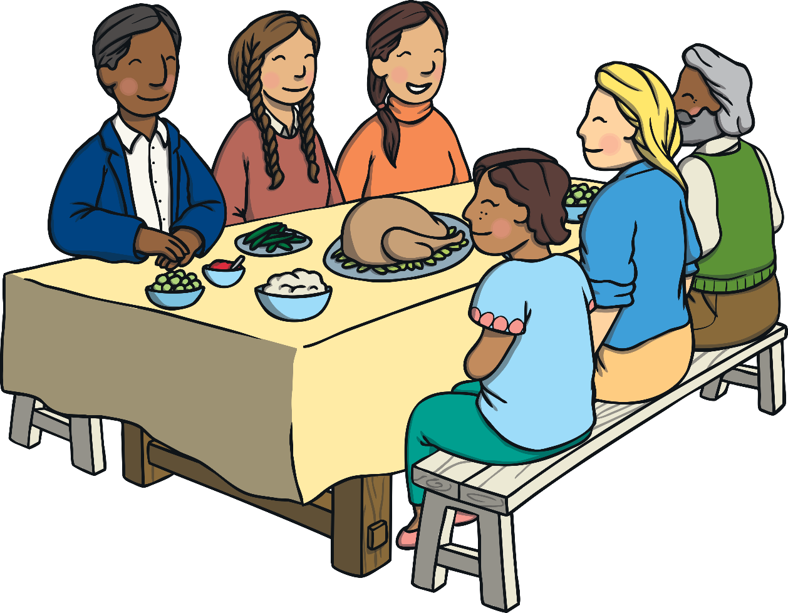
Food Energy
Both humans and animals get most of their energy from eating food.

Slide 5
Electricity
Electricity is a source of energy.

Slide 6
Electrical Energy
Electricity is made in big power stations and it travels along wires into our homes.

Slide 7
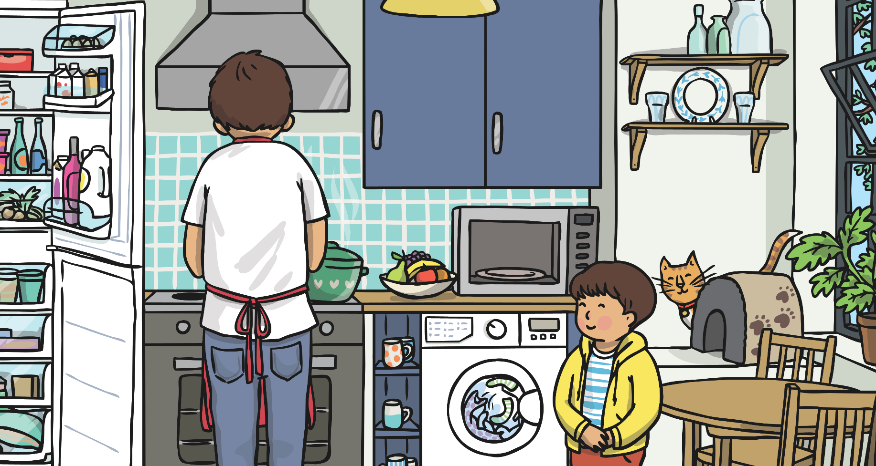
Appliances
Most appliances use electricity as a source of energy.

Slide 8
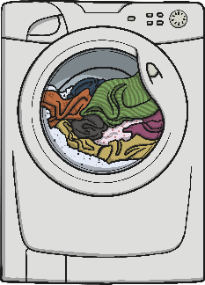
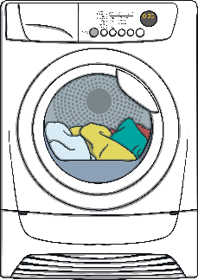
We use lots of different appliances in our homes. Can you think of any?

Slide 9
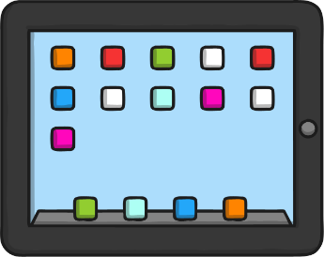
We use lots of different appliances in our school. Can you think of any?

