Slide 2
Writing to Persuade
When you are writing to persuade, you are trying to convince your reader to do something or to buy something. You can do this by using your words to encourage or influence them.
There are lots of different ways that you can write to persuade.
You might have been persuaded by:
letters;
leaflets.
Can you think of a time when you read or heard something really persuasive?

Slide 3
Features of Writing to Persuade
To try to influence your reader, you could include some of the following features:
Repeat the Main Ideas
I have tried very hard to be good this year.
I have also been very helpful all year.
Mentioning the main ideas more than once will help you to get your point across to the reader.
Facts or Key Information
Come to our school fair on Friday 12th July at 3 o’clock.
Add facts or key information to support your ideas.
Expanded Noun Phrases
a shiny, red scooter
some fun maths games
Use expanded noun phrases with amazing adjectives or modifying nouns to persuade the reader.

Slide 4
Can You Spot These Features?
Are the main ideas repeated?
Did you spot any facts or key information?
Are there any expanded noun phrases?
Click here to read the text.

Slide 5
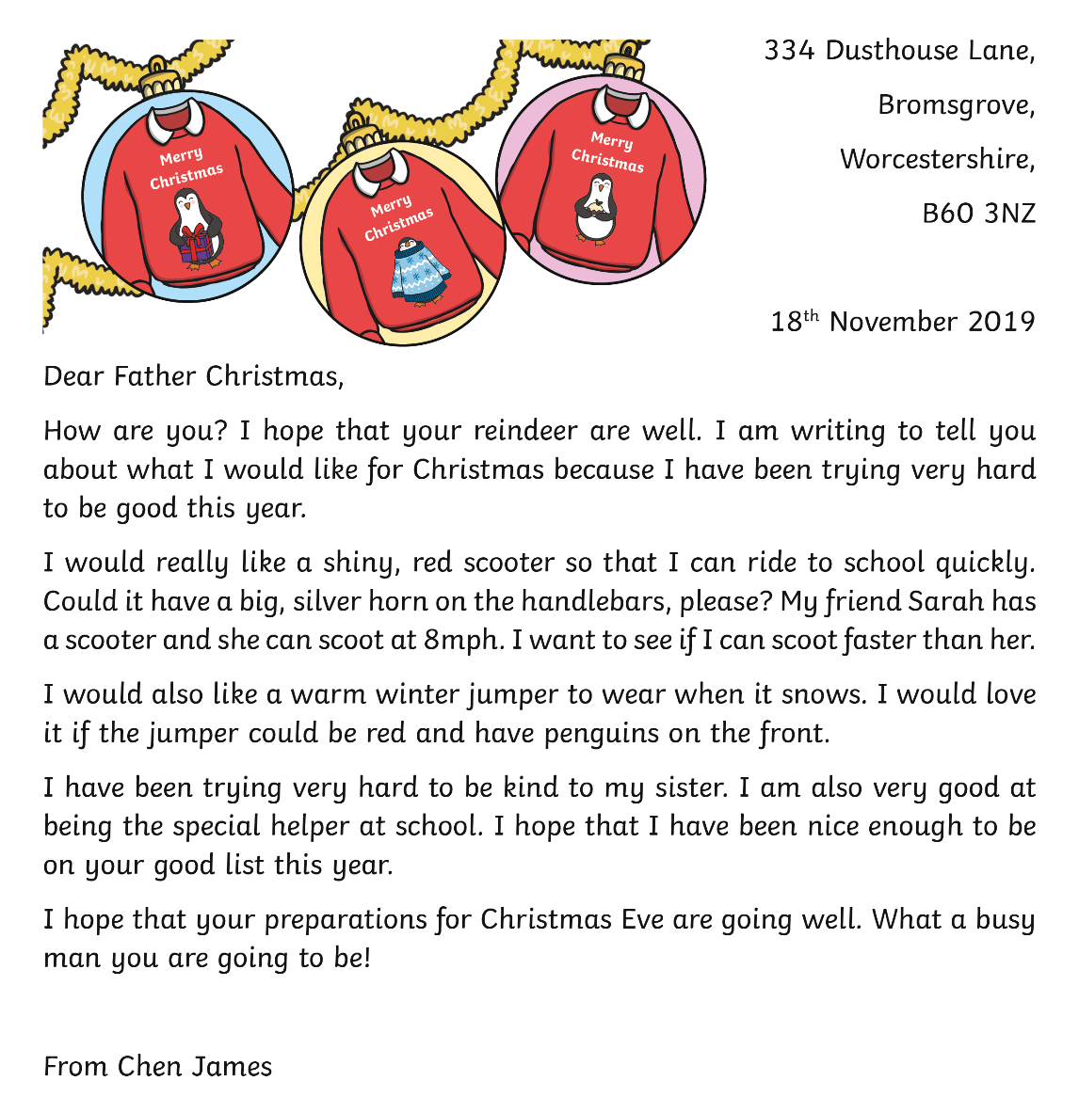
Can You Spot the Features in This Letter?
expanded noun phrases
Did you spot any other important features in this letter?
repeating the main ideas
facts or key information

Slide 6
Can You Spot the Features in This Leaflet?

Slide 7
Can You Spot the Features in This Leaflet?
repeating the main ideas
facts or key information
expanded noun phrases
Did you spot any other important features in this leaflet?

